Slide 1
UNIT-2

Slide 2
Problem Solving Agent
Problem-solving agent in Artificial Intelligence is goal-based agents that focus on goals.
Problem - solving agents decide what to do by finding sequences of actions that lead to desirable states.

Slide 3
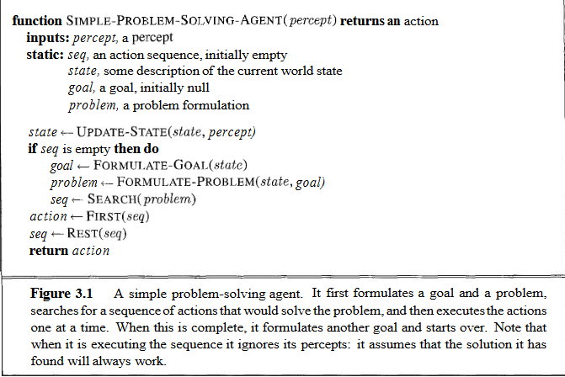

Slide 4
Formulate
Search
Execute

Slide 5
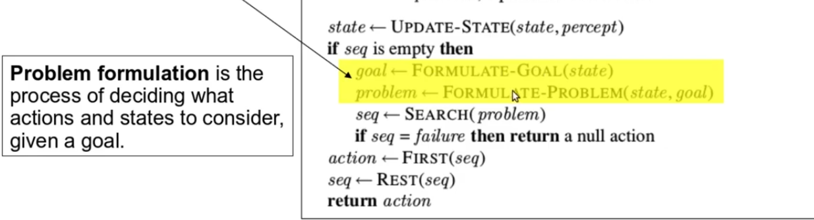

Slide 6
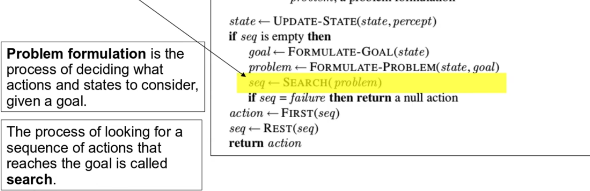

Slide 7
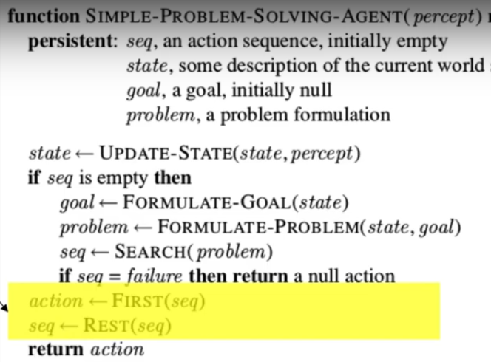
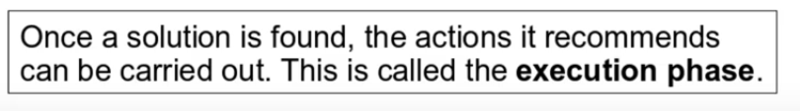

Slide 8
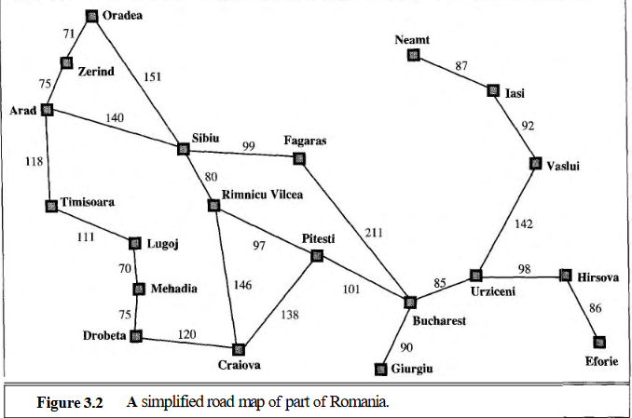

Slide 9
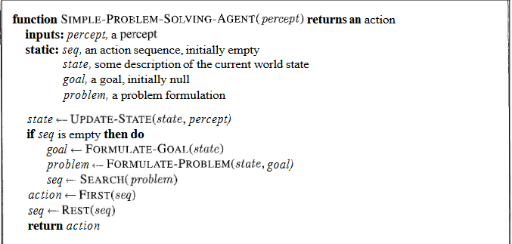
Percept: GPS
Passenger Input: Bucharest.

Slide 10
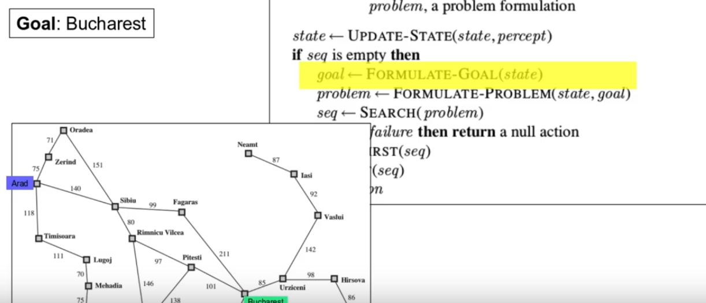

Slide 11
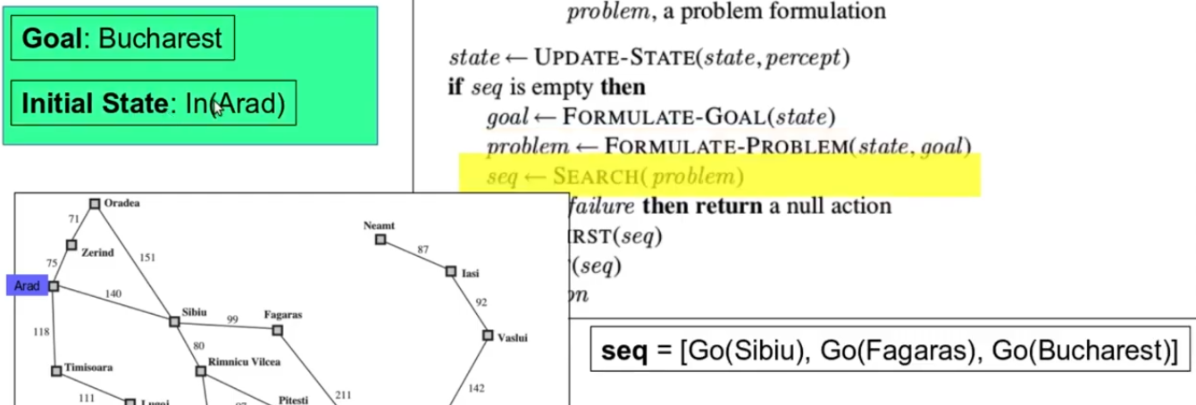

Slide 12
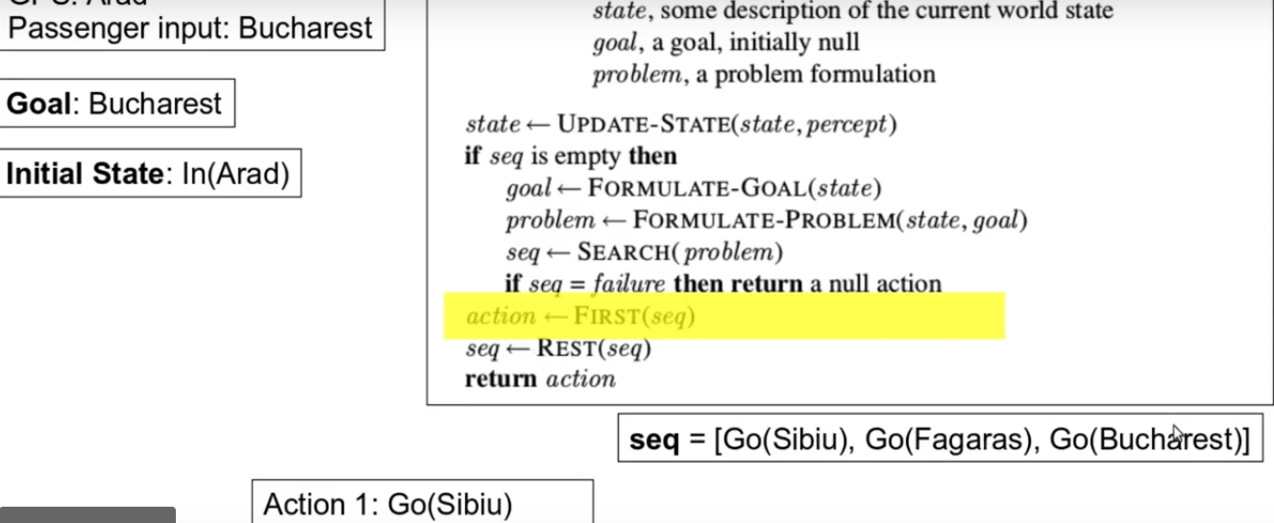

Slide 13
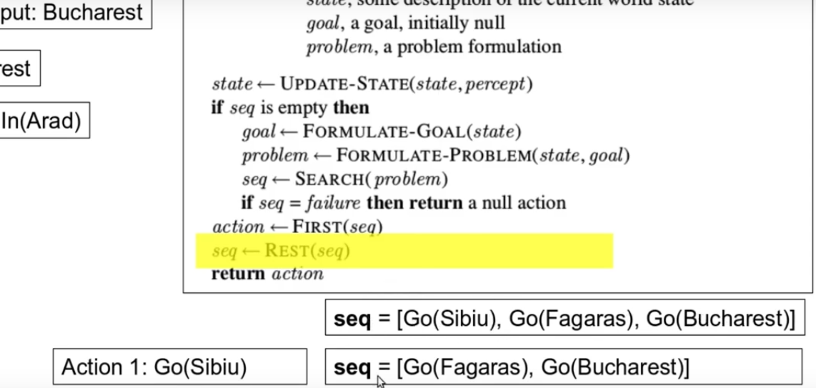

Slide 14
Once the action is complete, again the function new percept is called.

Slide 15
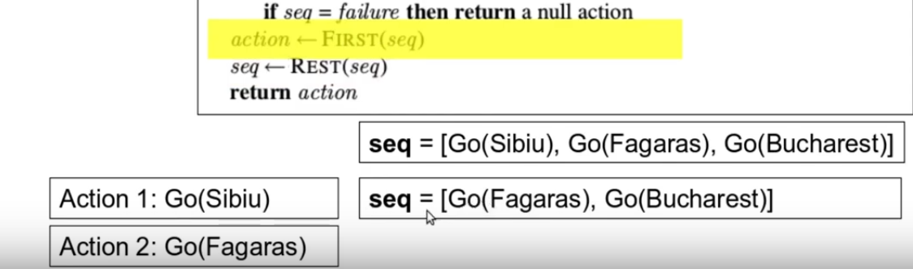

Slide 16
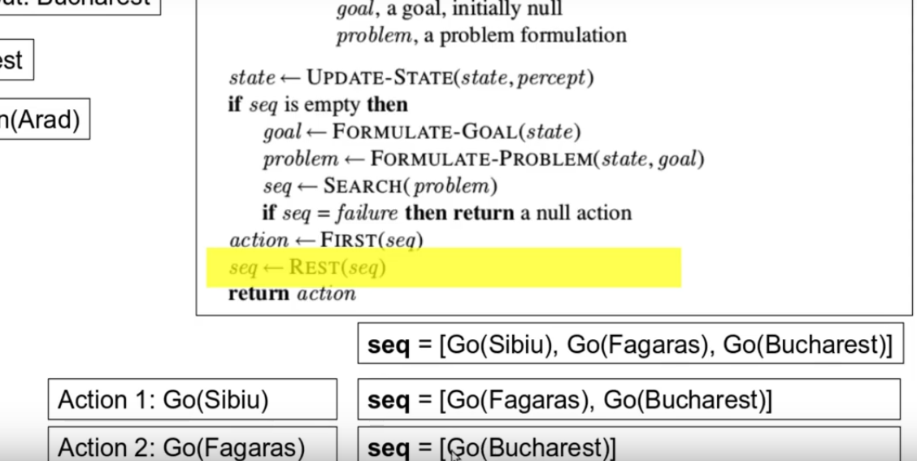

Slide 17
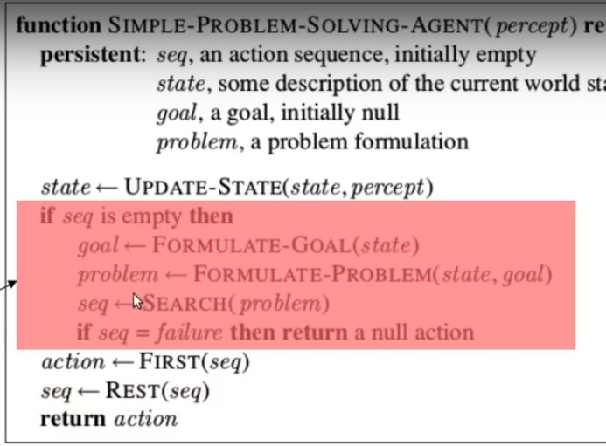
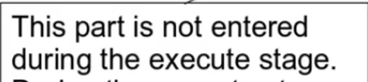
New percepts are ignored.

Slide 18
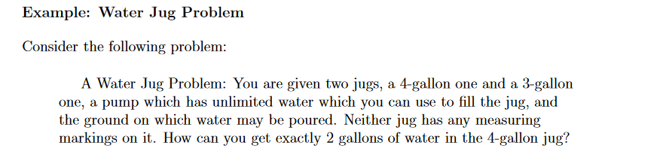

Slide 19
Toy problems
Water Jug problem

Slide 20
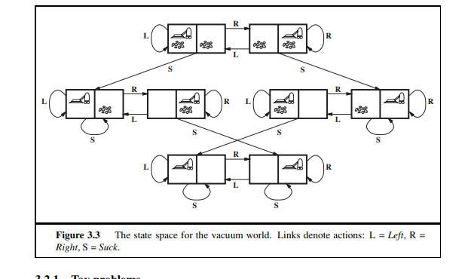
Toy problem

Slide 21
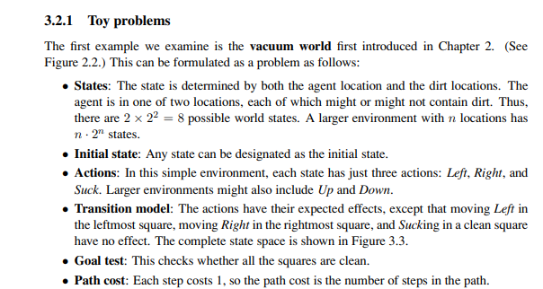

Slide 22
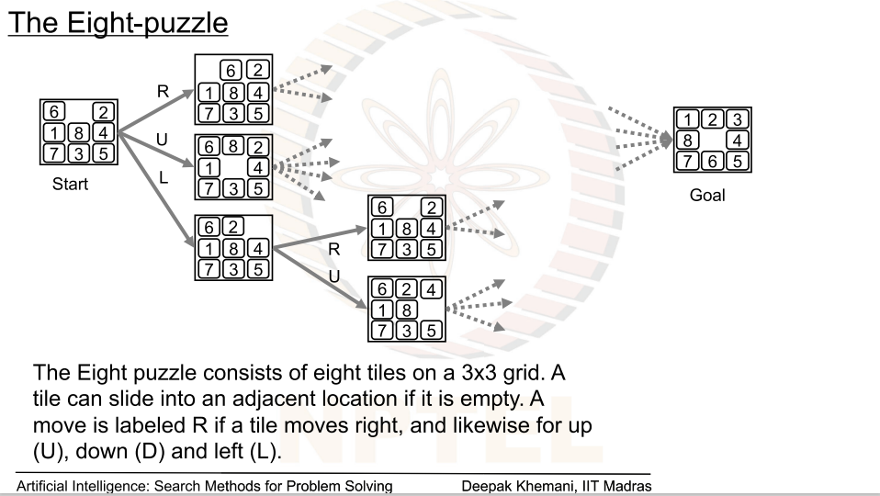

Slide 23
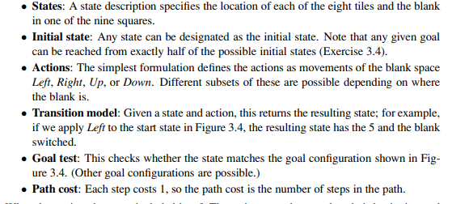

Slide 24
N-Queens Problem
N - Queens problem is to place n - queens in such a manner on an n x n chessboard that no queens attack each other.
Rules
every row should have a queen.
every column should have a queen.
None of the queens attack each other.

Slide 25
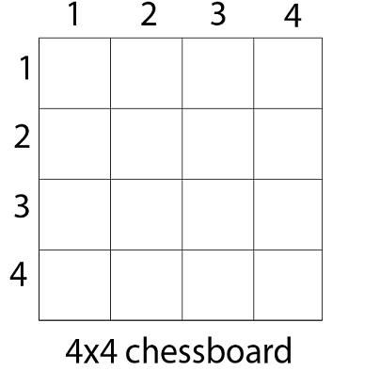

Slide 26
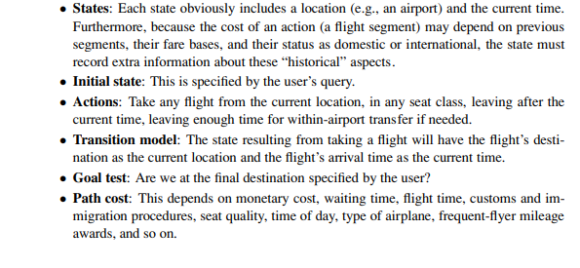
Real world Problems
Airline Travel problem

Slide 27
Touring problems are closely related to route-finding problems.
The traveling salesperson problem (TSP) is a touring problem in which each city must be visited exactly once.
Robot navigation

Slide 28
How decisions are taken ?
1. Knowledge base
memory based.
rule based.
2. Searching

Slide 30
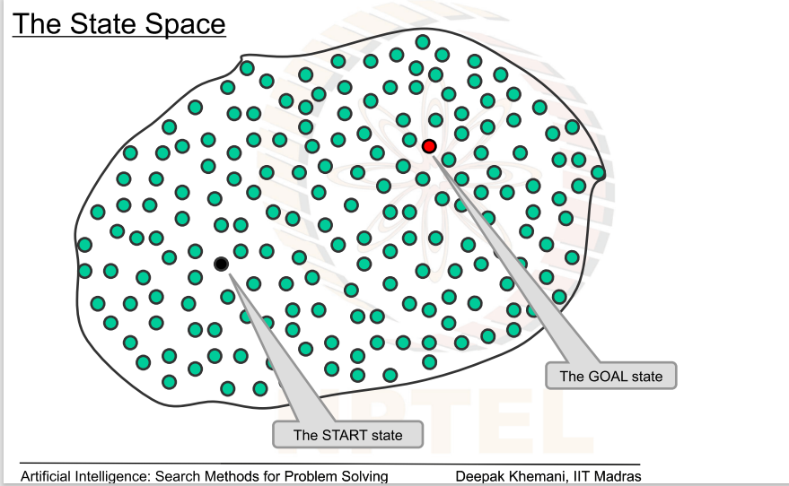

Slide 31
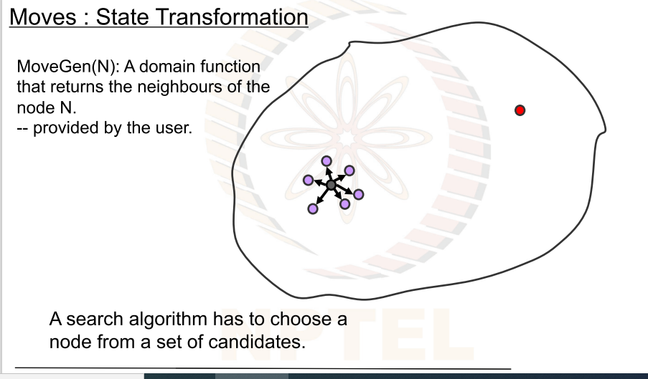

Slide 32
Puzzle
Man,Goat,Lion,Cabbage.
There is a farmer who wishes to cross a river but he is not alone. He also has a goat, a Lion, and a cabbage along with him. There is only one boat available which can support the farmer and either of the goat, wolf or the cabbage. So at a time, the boat can have only two objects (farmer and one other).

Slide 33
How decisions are taken ?
1. Knowledge base
memory based.
rule based.
2. Searching
Domain Independent algorithm

Slide 34
How to solve any puzzle
Is it possible to generate algorithm or program which solves any puzzle.
Representation of states is very important.
What is MovGen function.

Slide 35
MovGen(S)- this function returns neighboring nodes of S.

Slide 36
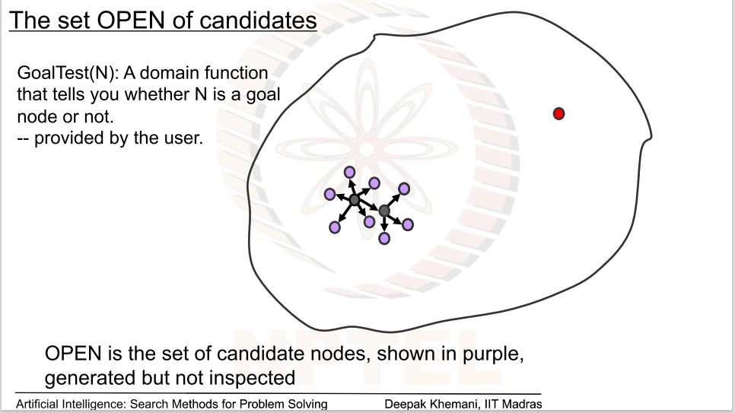

Slide 37
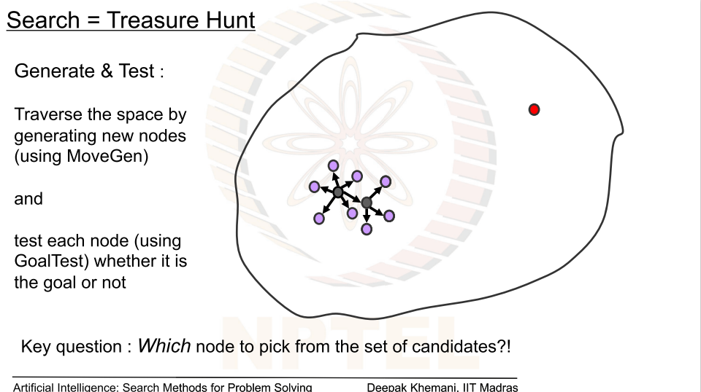

Slide 38
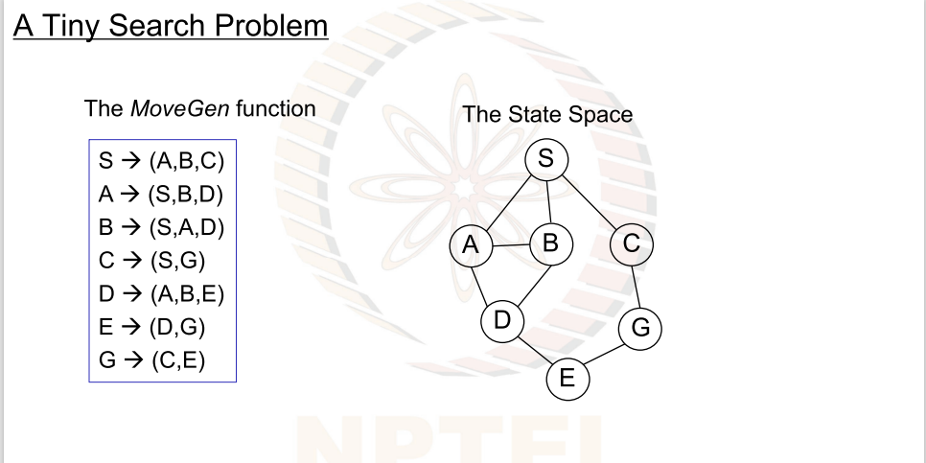

Slide 39
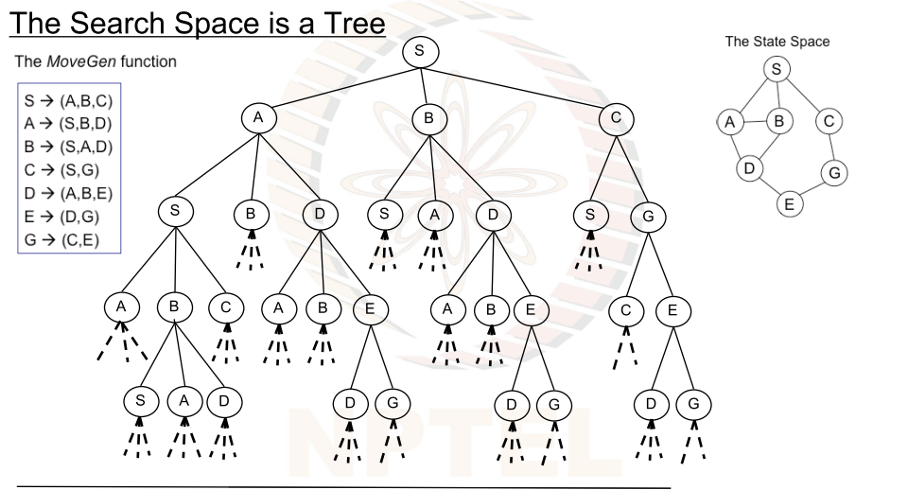

Slide 40
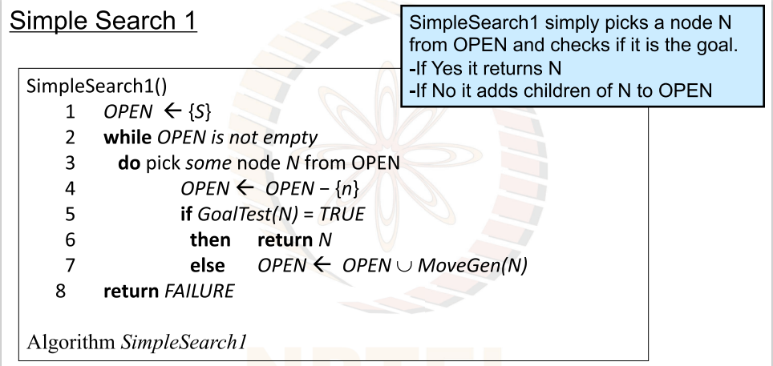

Slide 41
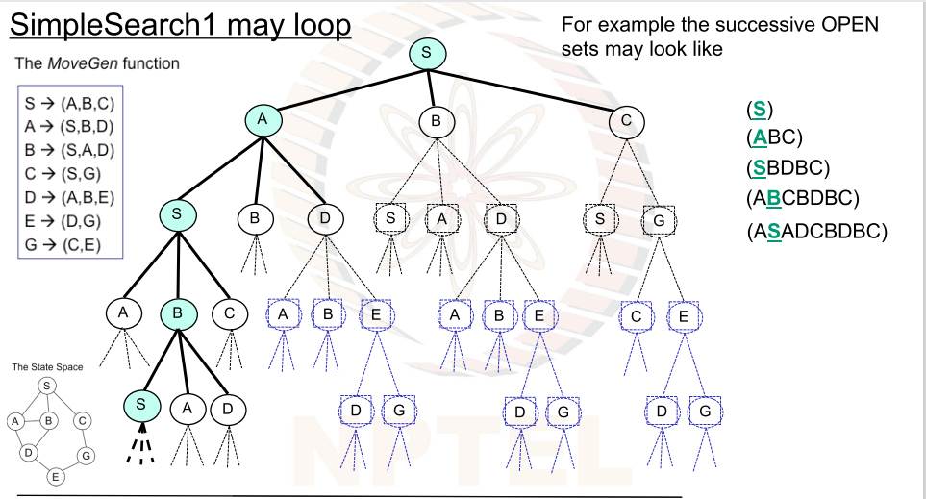

Slide 42
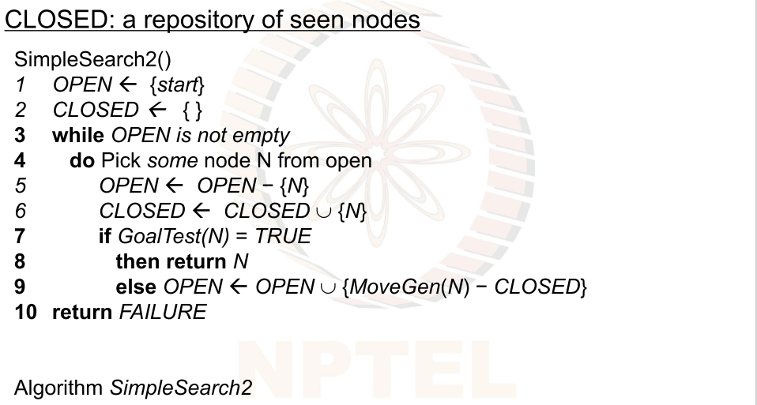

Slide 43
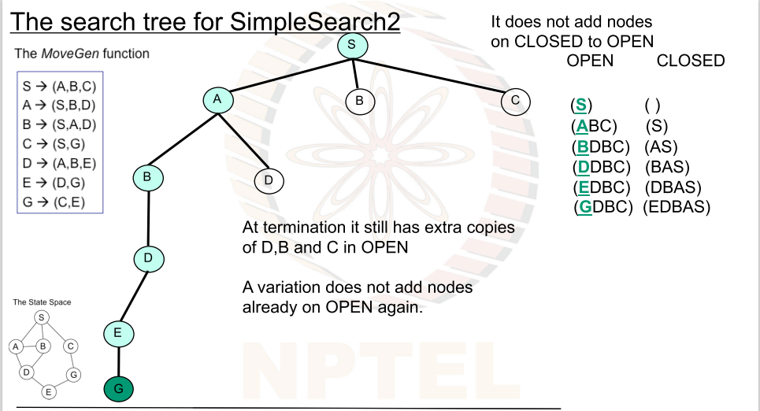

Slide 44
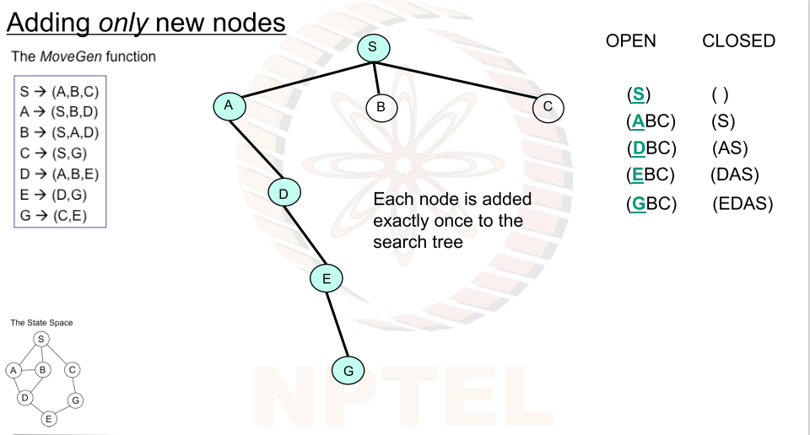

Slide 45
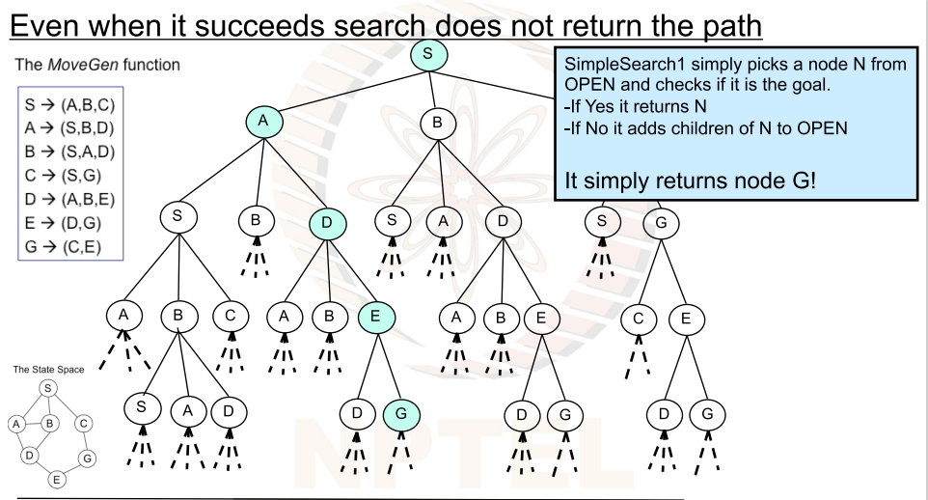

Slide 46
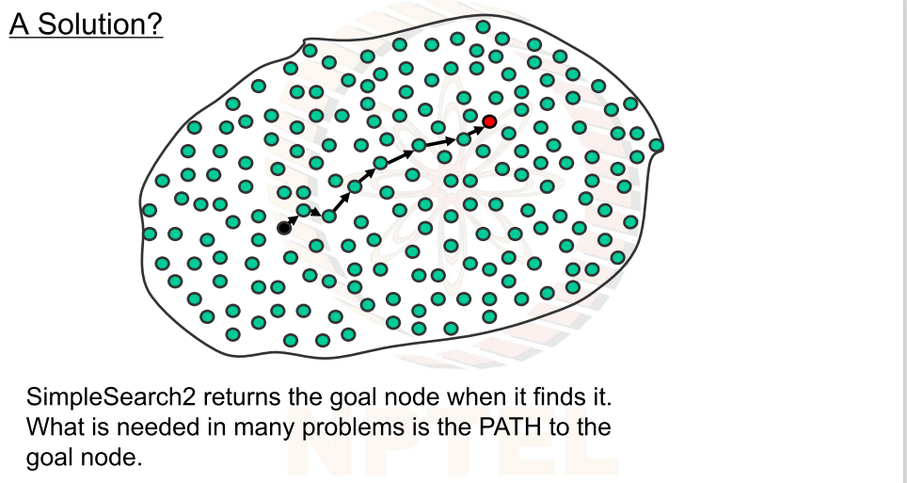

Slide 47
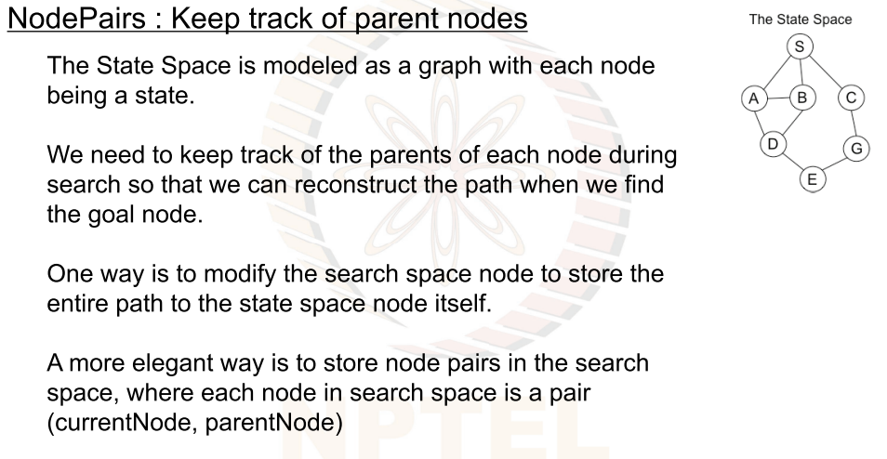

Slide 48
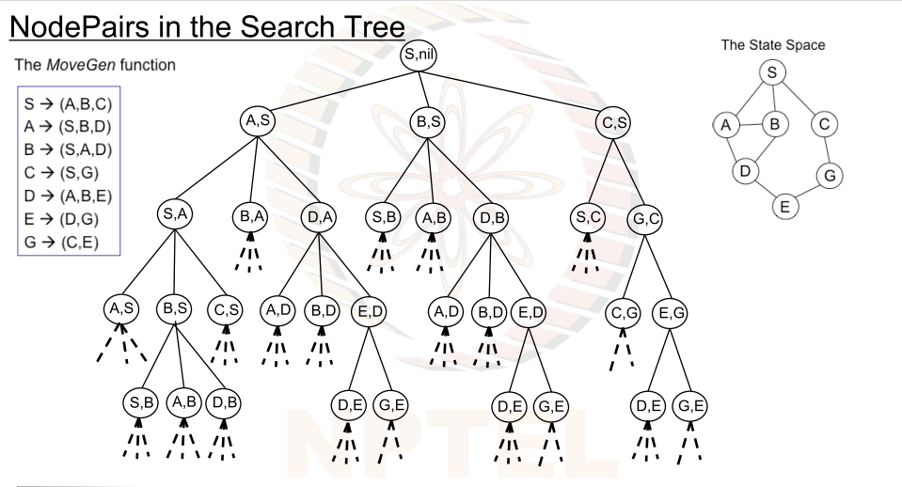

Slide 49
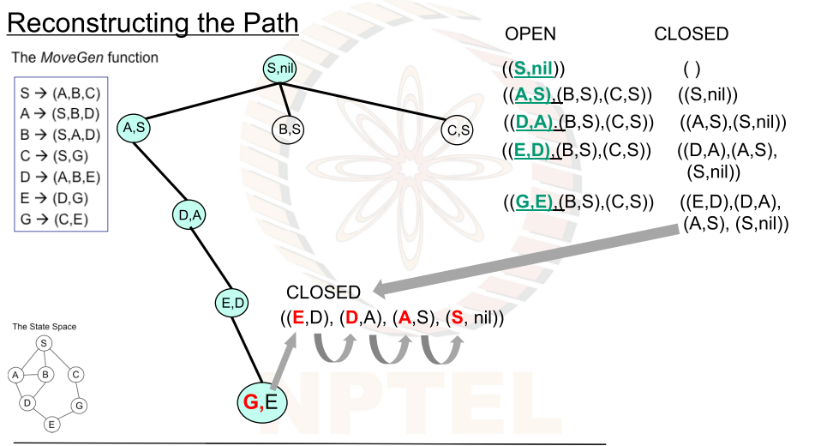

Slide 50
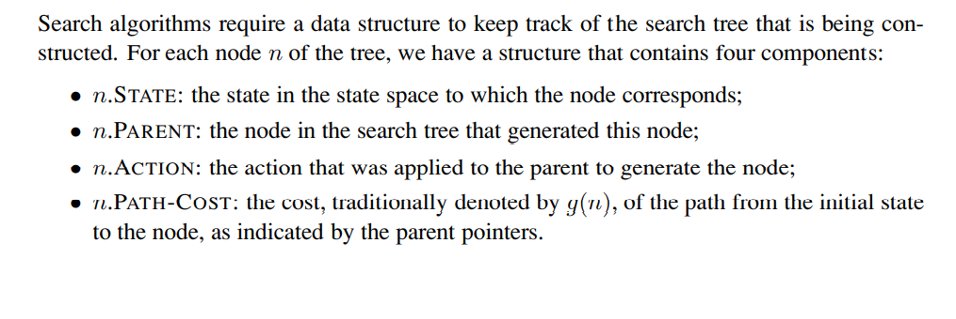
Infrastructure for search algorithms

Slide 51
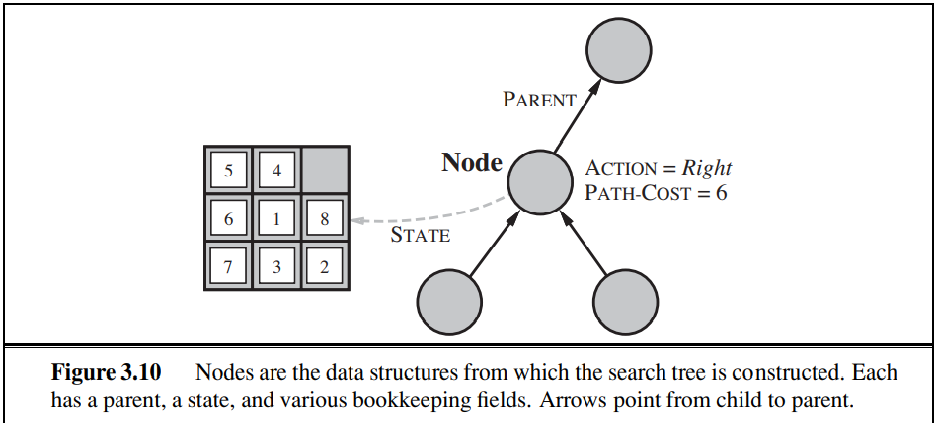

Slide 52
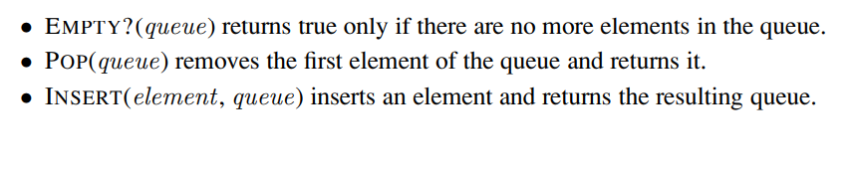
Data structure used
Queue-FIFO, LIFO, PRIORITY

Slide 53
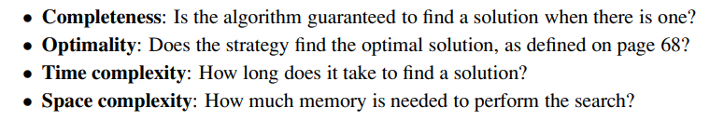
We can evaluate an algorithm’s performance in four ways

Slide 54
Also called as Blind Search.
The term means that the strategies have no additional information about states beyond that provided in the problem definition.

Slide 55
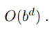
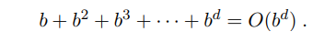
Breadth-first search
This algorithm selects a single node (initial or source point) in a graph and then visits all the nodes adjacent to the selected node.
Uses FIFO (queue)
Complete
optimal
Time complexity
b- branching factor
d- depth
Total number of nodes generated=

Slide 56
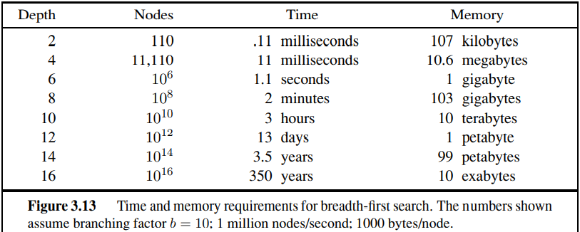

Slide 57
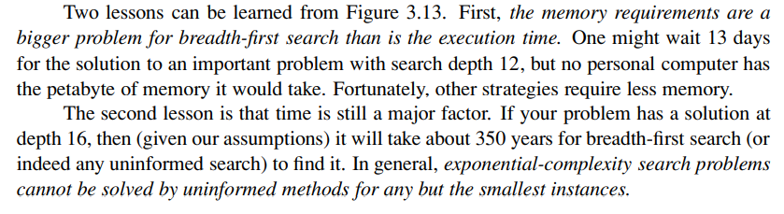
Problems with BFS

Slide 58
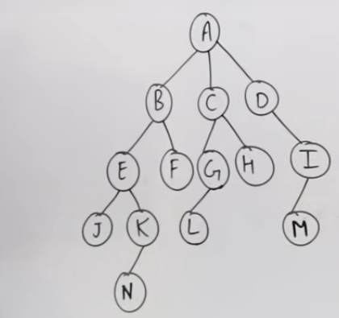
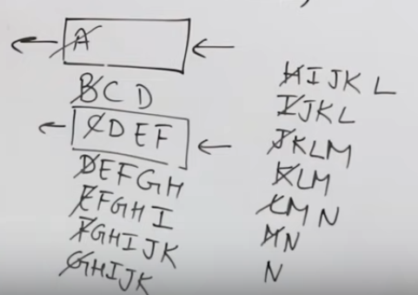
Example-1
b=3 and d=2 then timecomplexity=9. In 9searches you will get the answer.

Slide 59
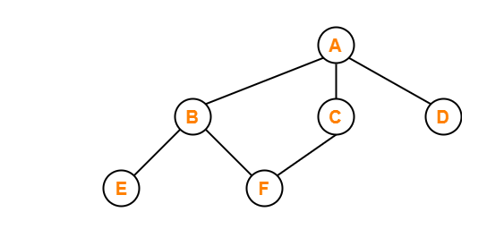
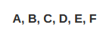
Example-2

Slide 60


